Slide 1
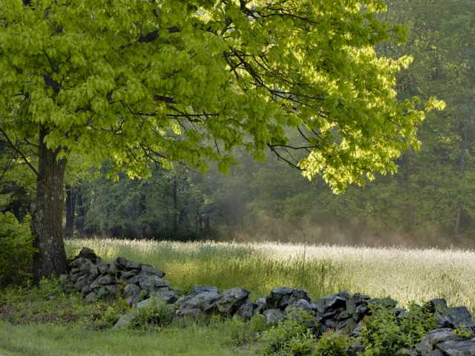

Implementing
the Community Preservation Act

Slide 2

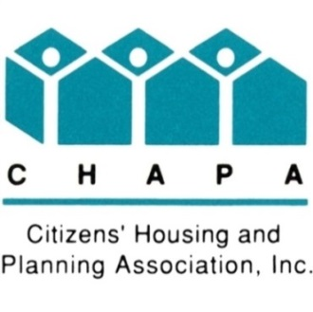




About the Coalition
Representatives from 4 member communities and 4 at-large members

Slide 3
The Community
Preservation Coalition
Technical assistance
Website
Email newsletter & bulletins
CPA advocacy and legislation
Ballot measures (adoption, changes)
Training conferences, webinars,
presentations, publications, workshops
Supported by membership dues from CPA communities

Slide 4
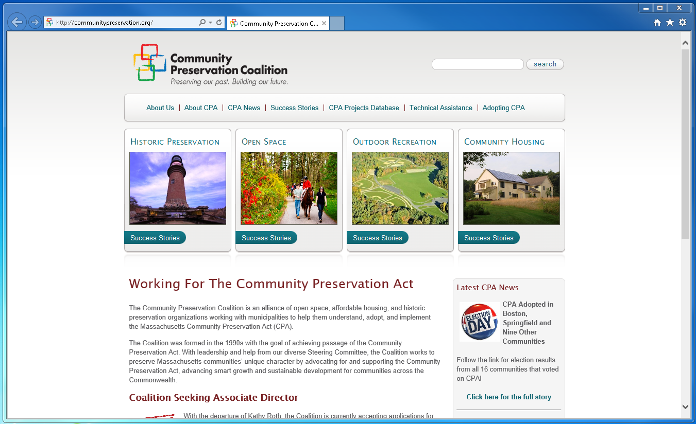
Coalition Website
www.communitypreservation.org

Slide 5
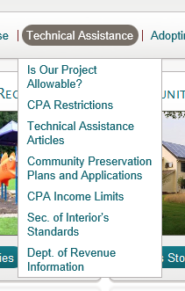
Technical Assistance Resources

Slide 6
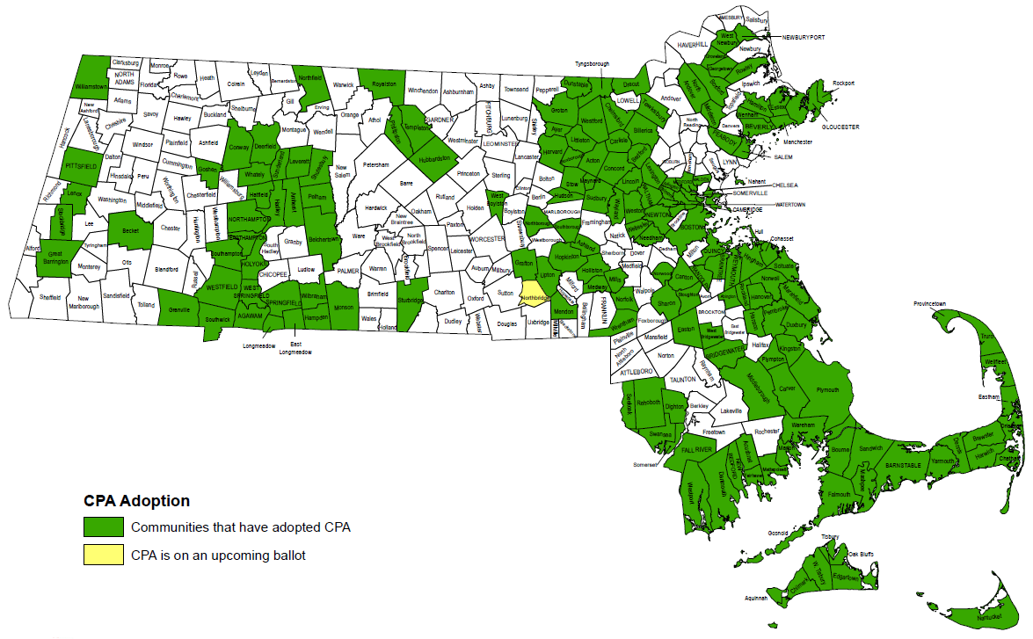
172 CPA Communities
Notes:
6

Slide 7




CPA by the Numbers
(through FY2017)
HISTORIC PRESERVATION: Over 4,750 appropriations
OPEN SPACE: 28,047 acres preserved
OUTDOOR RECREATION: About 1,950 projects funded
AFFORDABLE HOUSING: Over 13,000 units created or supported
- Over 9,900 projects approved & $1.75 billion raised -

Slide 8
The CPA Trust Fund
Administered by the Department of Revenue (DOR)
Funds come from $10 and $20 fees charged at the Registries of Deeds
All communities received at least 17.2% match this year

Slide 9
CPC –First Year Responsibilities
Assess Community Preservation needs of your city (Review Master Plan, Open Space Plan, Housing Plan, etc.)
Meet with other committees and boards
Hold public hearing to get input on CPA priorities
Prepare Community Preservation Plan

Slide 10
CPC Ongoing Requirements
• Hold at least one public hearing per year
Update Community Preservation Plan
Review CPA account balances & spending to ensure compliance with the Act allowable uses
Prepare CPA budget for legislative body
Make project recommendations to legislative body

Slide 11
CPA Annual Budget
Usually done at same time as city budget
Final deadline for budget: Before tax rate set
Requires CPC recommendation to legislative body

Slide 12
CPA Annual Spending/Set-aside Requirements

Slide 13
CPA Annual Budget (FY19 on)
Required minimum spending (or reserve):
10% of total revenue for housing projects
10% for historic projects
10% for open space & recreation projects
• Optional:
Up to 5% for administrative expenses
Appropriations for new CPA projects
Balance goes in a “budgeted reserve”
Note: Interest earned is credited to CPA Fund

Slide 14
CPC Administrative Account
  CPC can request up to 5% of estimated revenues for expenses to run CPC
  Unspent balance returned to undesignated
  fund at end of FY
  For CPC expenses only, not reimbursements to other municipal departments or to pay other municipal staff

Slide 15
Administrative Account
Common Uses
  Hire administrative assistance
  Professional help: Appraisals, consultants, legal assistance, general studies
  Due diligence on project recommendations
  Newspaper ads for public hearing
  Misc. expenses

Slide 16
Borrowing Permitted under CPA
Can be used right away, if needed
Can only bond against local surcharge, not state match
Two-thirds vote needed to pass bonded projects at Legislative Body
Cannot pay debt service on non-CPA bonds

Slide 17
Budget and Project Planning
City Budget
100%
CPA Funds
1%

Slide 18
Determining Project Eligibility
It’s all about the VERBS!
 | Open Space | Historic | Recreation | Housing
Acquire | Yes | Yes | Yes | Yes
Create | Yes | - | Yes | Yes
Preserve | Yes | Yes | Yes | Yes
Support | - | - | - | Yes
Rehabilitate and/or Restore | Yes – if acquired or created w/CPA $$ | Yes | Yes | Yes – if acquired or created w/CPA $$

Slide 19
Basic Tenets of CPA Spending
No supplanting general municipal revenue
No maintenance or operating expenses
Recreation – Outdoor projects only
Asset Purchases – Must file permanent restriction with the state, held by 3rd party
Projects may not be voted on at Legislative Body unless CPC has first issued a positive recommendation
City Departments apply for funding to CPC

Slide 20
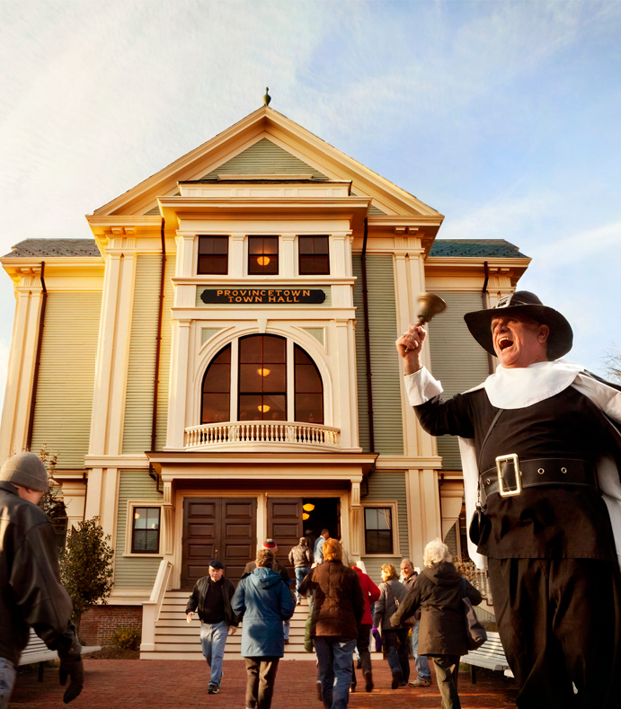
How do CPA Projects Happen?
Project proponents submit applications to Community Preservation Committee (CPC)
CPC reviews projects, gets input
CPC recommends list of projects to Legislative Body
Majority vote of Legislative Body required for each project to get CPA $$$
Notes:
Provincetown City Hall Celebration following complete rehabilitation with CPA funds

Slide 21
Project Recommendations
Should include amount in dollars and the funding source (which CPA account?)
Should include name of board/commission or other party that is carrying out project
Should include details of the project
Should include CPA “verbs” that justify project
CPC may include specific conditions

Slide 22
Sample Project
Recommendation/Warrant Article
ARTICLE 36. To see if the City will vote to appropriate $53,500 from the Historic Resources Reserve of the Community Preservation Fund to fund Phase I of the Cambridge City Clerk’s project for preservation of historic city records; said funds to be expended under the direction of the Community Preservation Committee and City Clerk.

Slide 23
Legislative Body Actions Are Limited
Approve recommendations of CPC
Reject recommendations of CPC
Reduce amount recommended by CPC
Reserve amount recommended by CPC to applicable reserve account, rather than approving the project (rarely used)

Slide 24
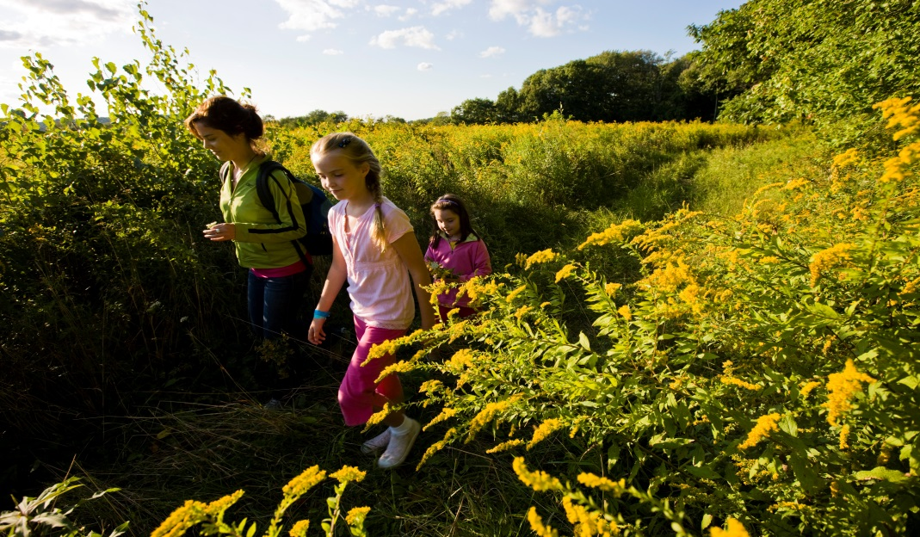
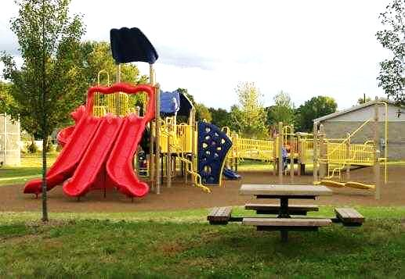
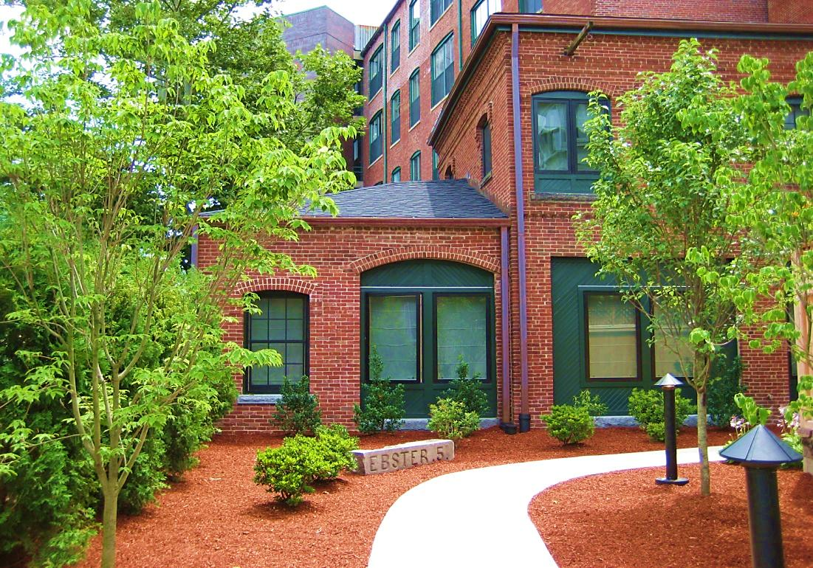
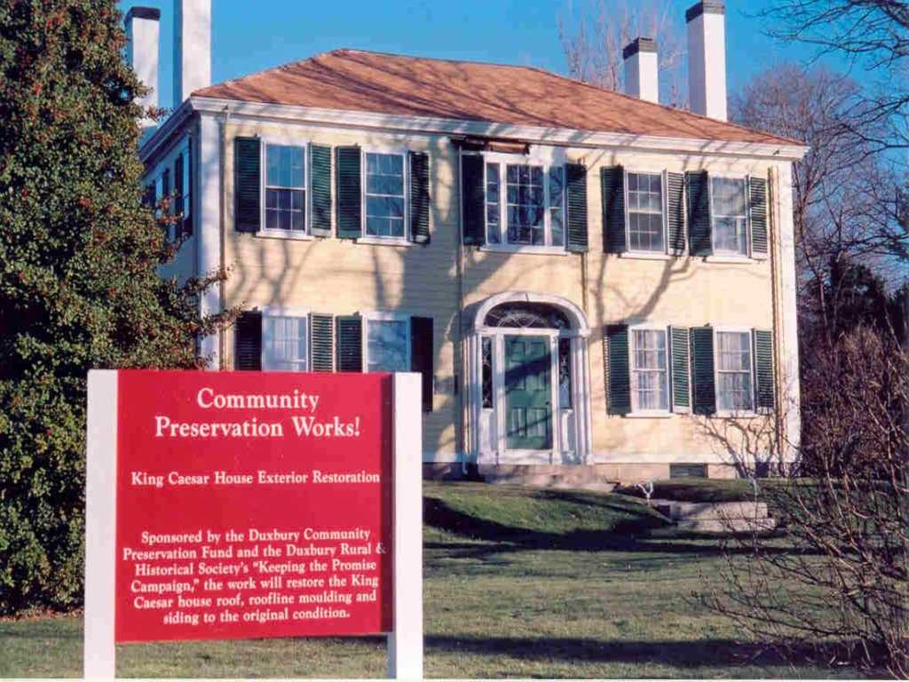
Potential Uses of CPA Funds
Notes:
Open space preserved in Grafton
Playground in Agawam
Duxbury Historic Home Preservation
Affordable Housing in Cambridge

Slide 25
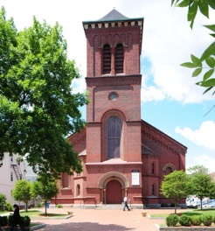
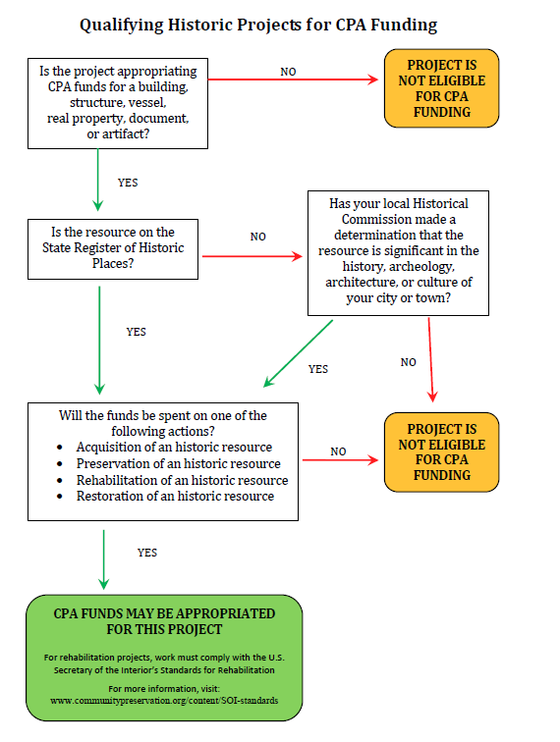
Historic Projects Flowchart

Slide 26

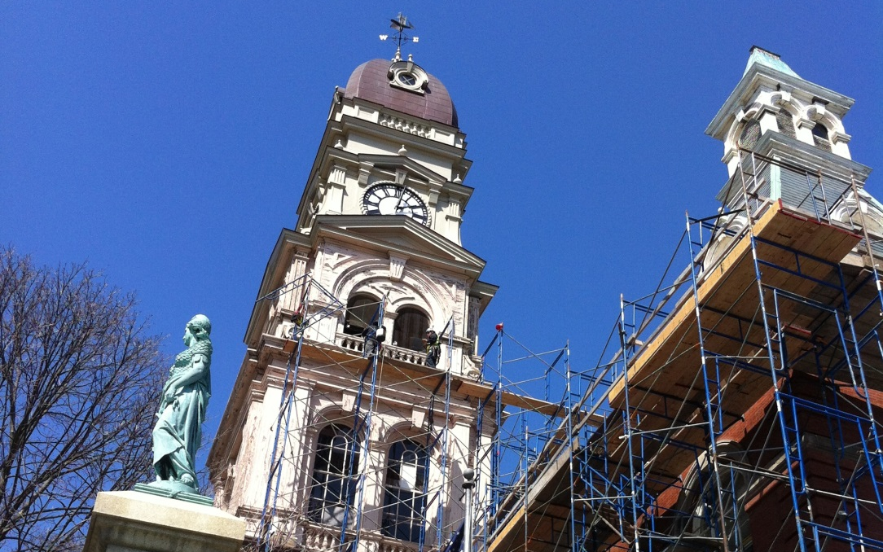
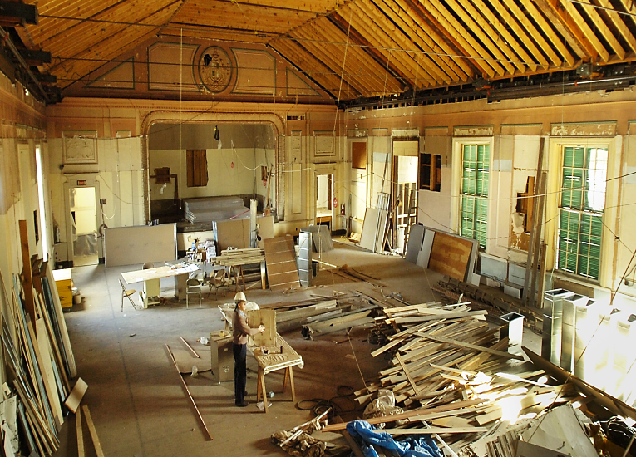
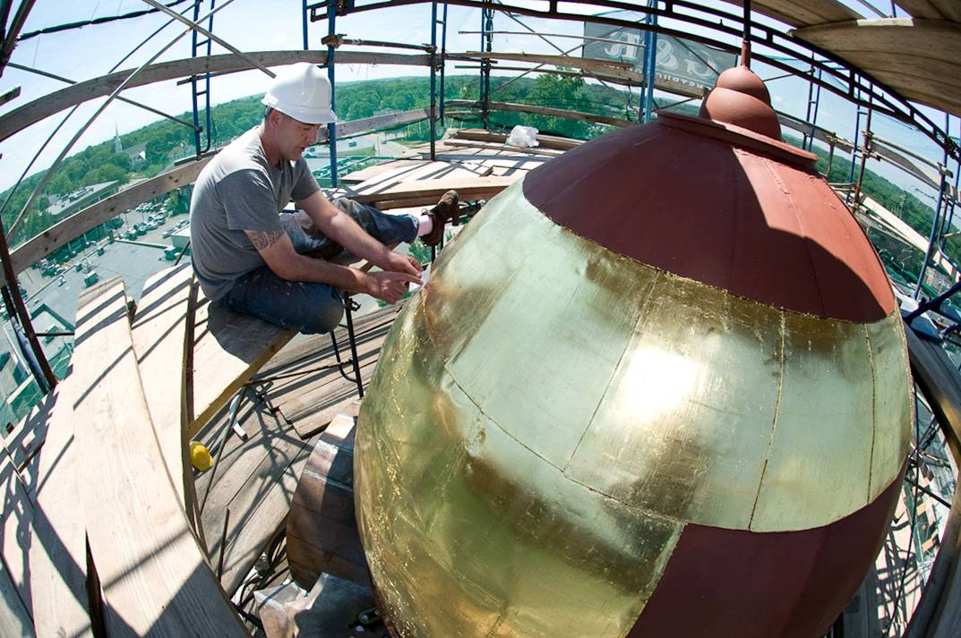
CPA and Historic Preservation
Restoration of historic
municipal buildings
Notes:
Gloucester city Hall
Randolph Stetson Memorial Hall
Sandwich City Hall

Slide 27
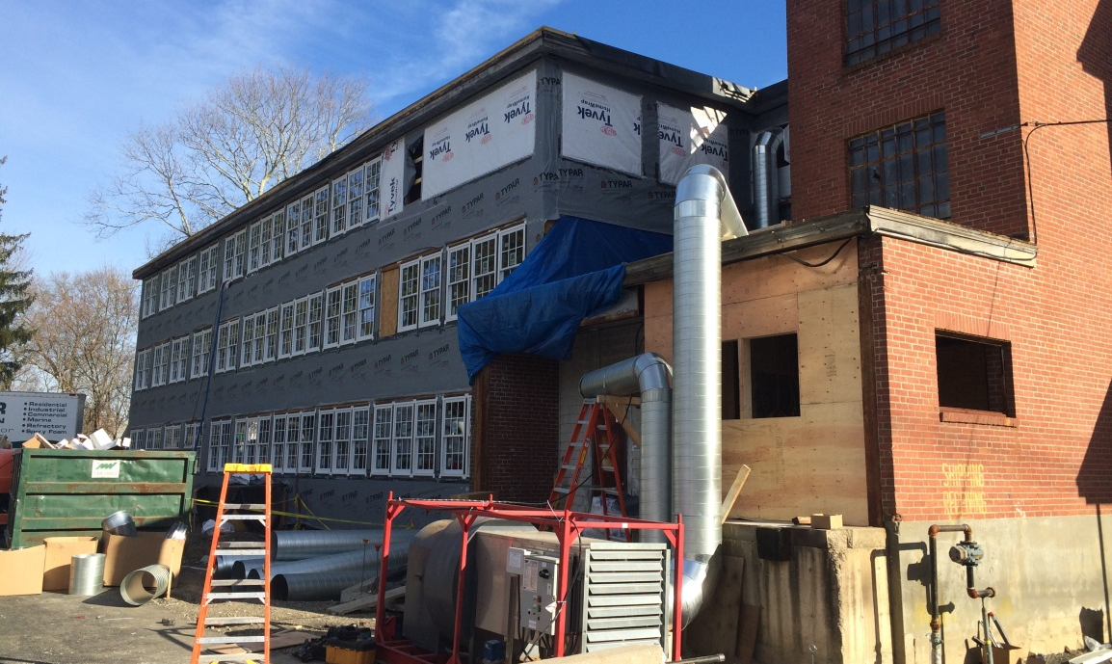
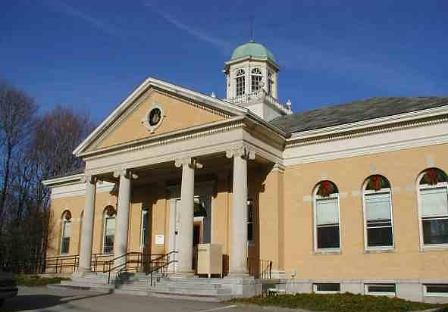
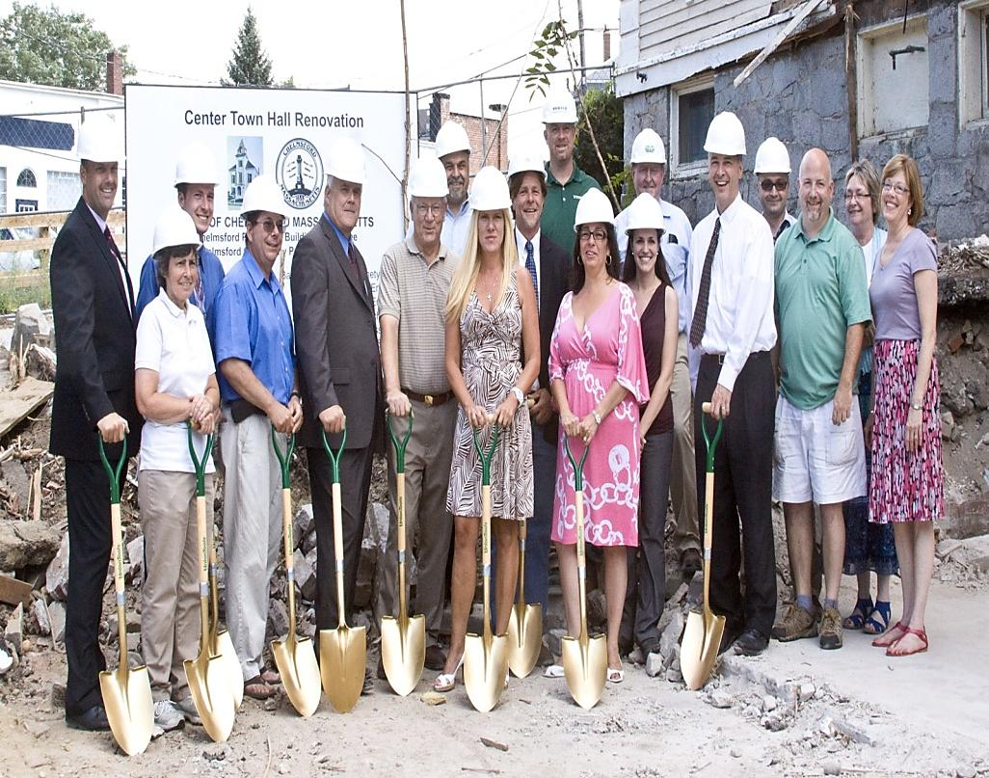
CPA and Historic Preservation
Adaptive Reuse of Historic Buildings
Notes:
Lexington Historic Print Shop turned into housing for Brain-injured adults
Chelmsford City Hall turned into a Community Arts center
Cohasset Library turned into Affordable Housing for seniors

Slide 28
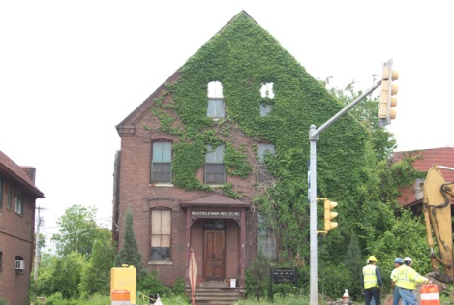
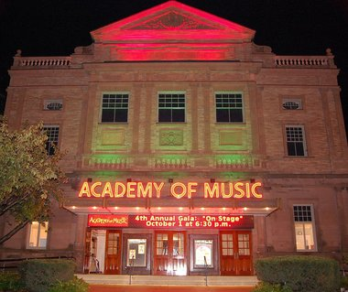
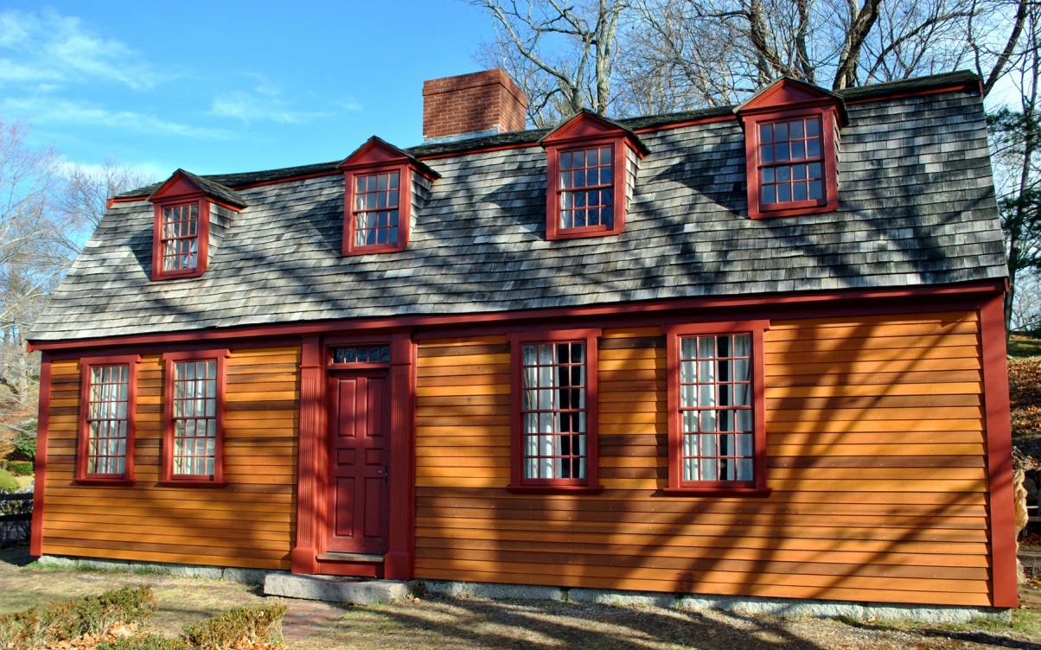
CPA and Historic Preservation
Grants to non-profit community groups (typically with a preservation easement)
Notes:
- Concord historic rehabilitation of theatre for the arts

Slide 29
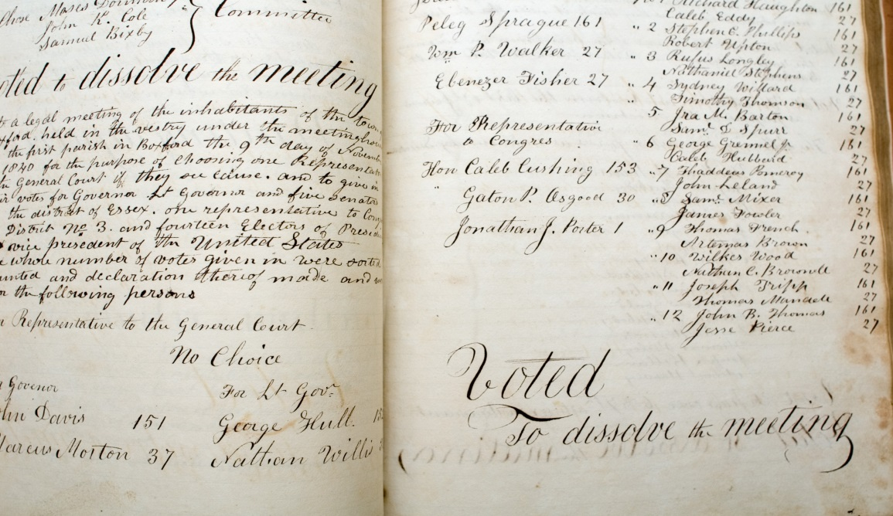
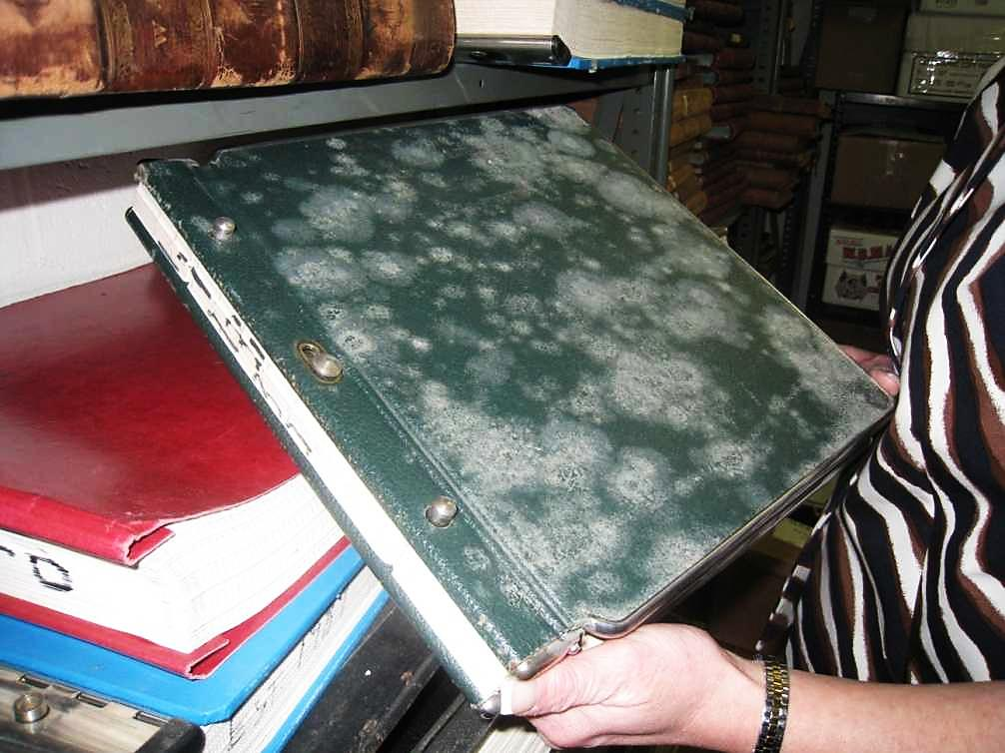
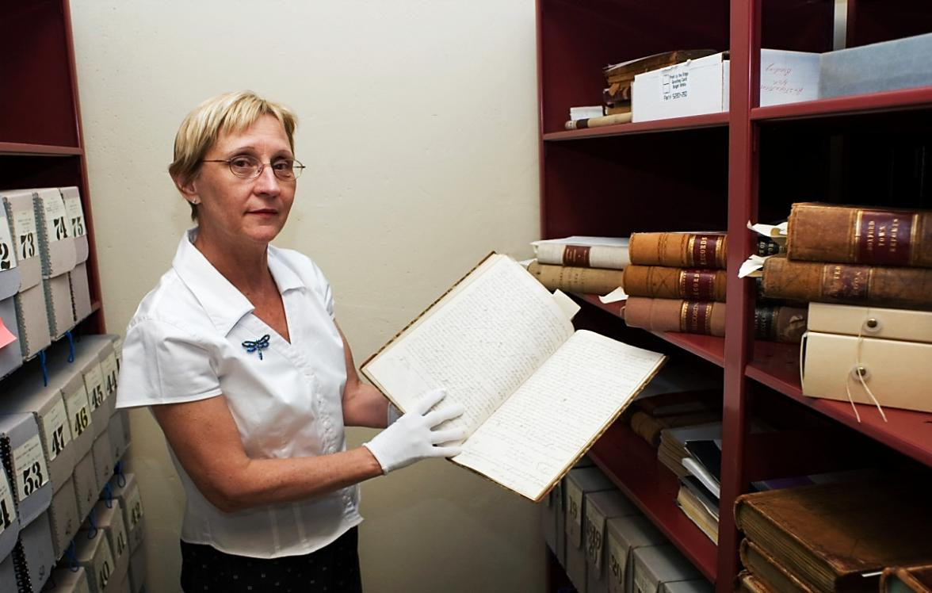
CPA and Historic Preservation
Historic Municipal
Document Preservation
Notes:
Boxford City Records
“ “ “
- Mendon City Records pre preservation/restoration

Slide 30

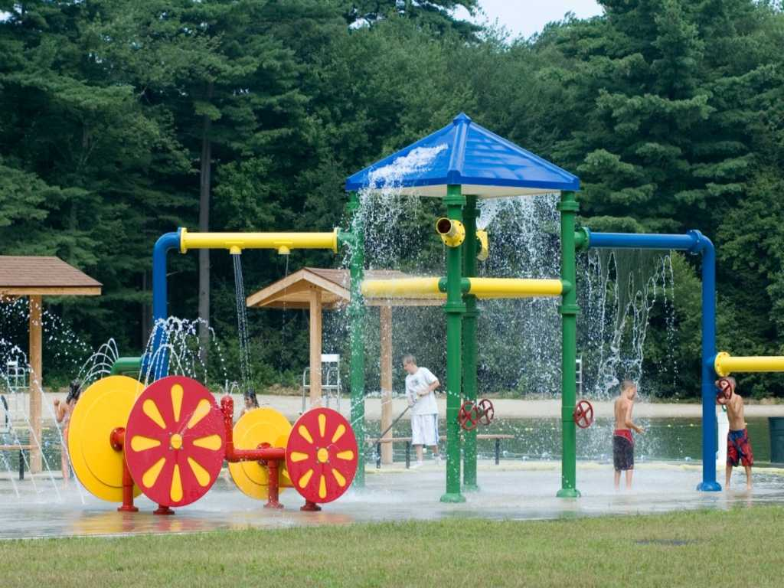
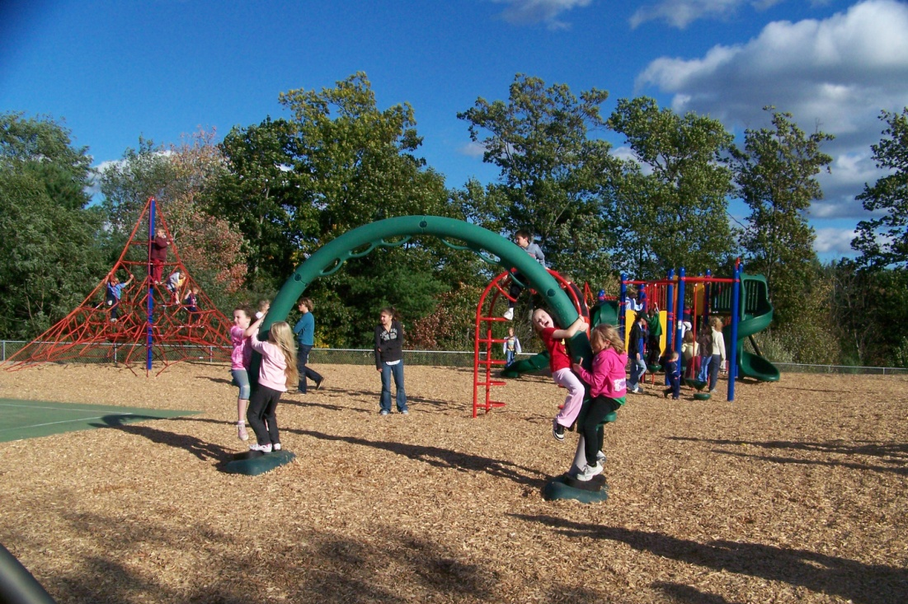
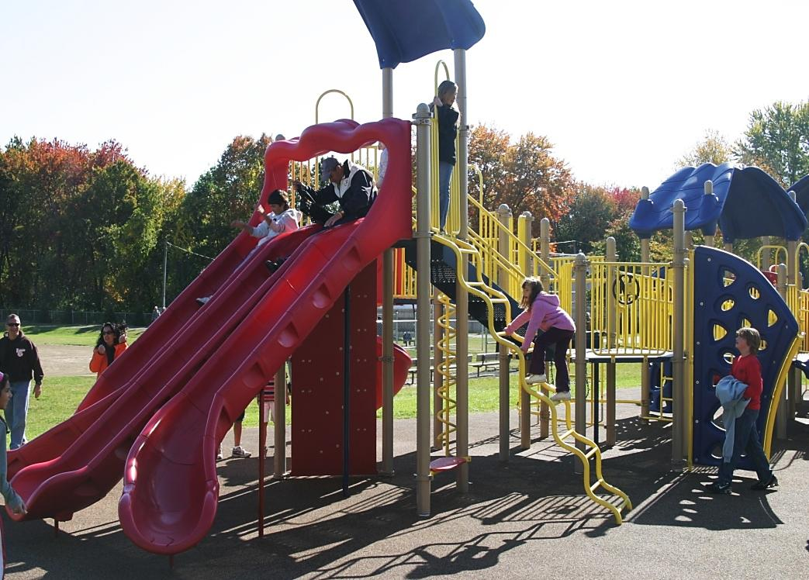
CPA and Open Space/Recreation
Playgrounds
Notes:
Bedford splash park
Agawam playground
Belchertown playground

Slide 31
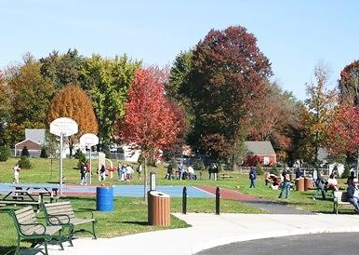
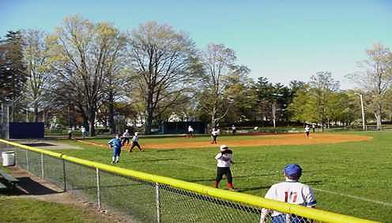
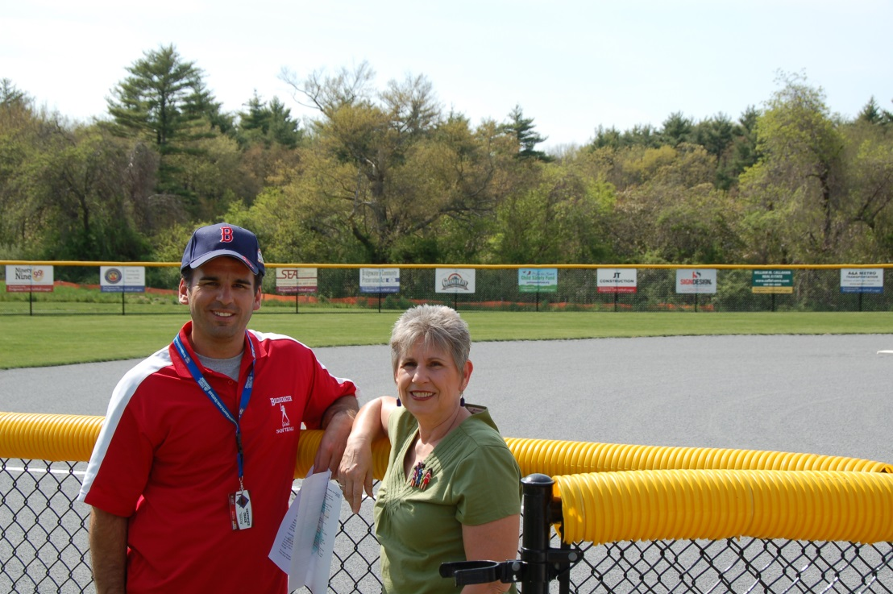
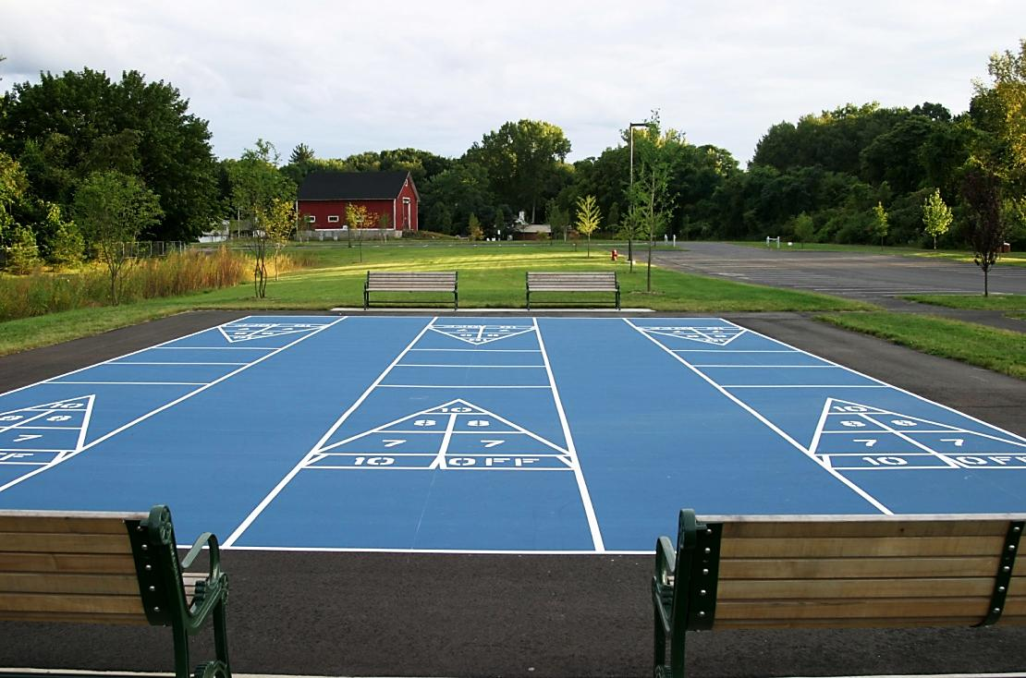
CPA and Open Space/Recreation
Athletic Fields
Notes:
Agawam athletic fields
Bridgewater new girls’ softball fields with Rec. Director and CPC Chair
Sudbury playing fields

Slide 32
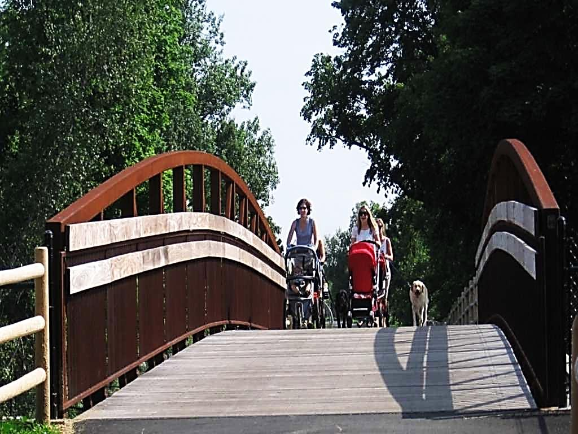
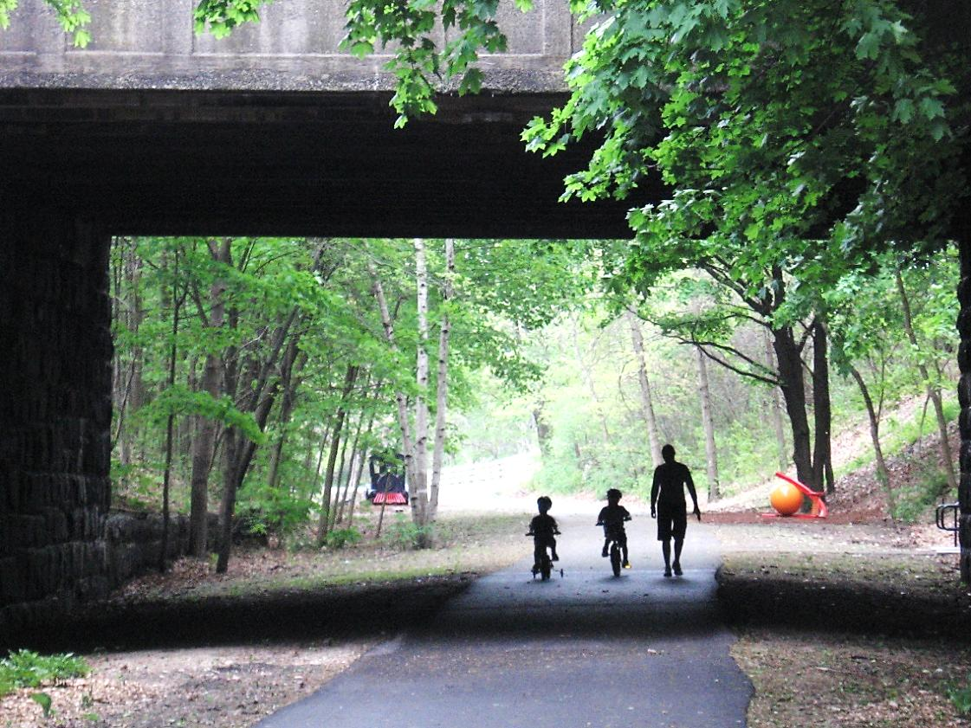
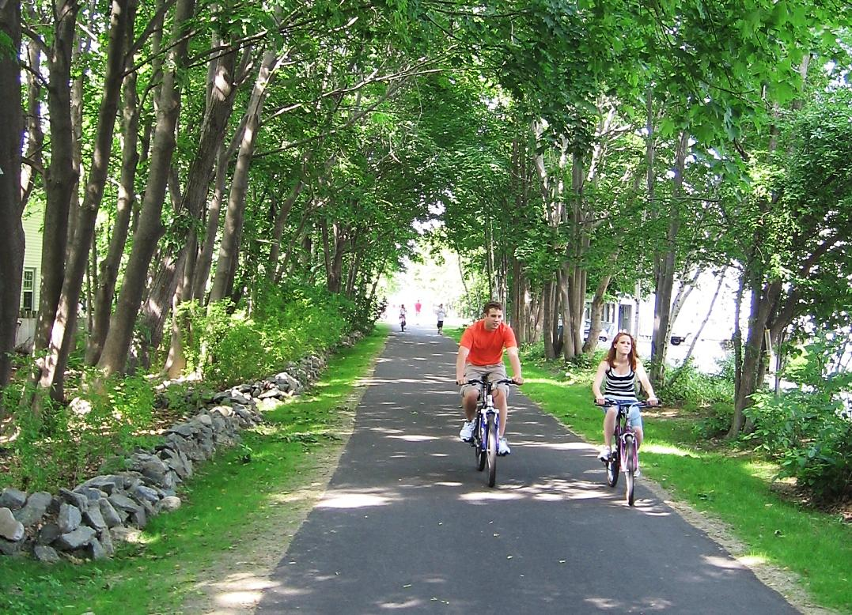
CPA and Open Space/Recreation
Hiking and Biking Trails
Notes:
Newburyport Clipper city Rail Trail
“ “ “
“ “ “

Slide 33
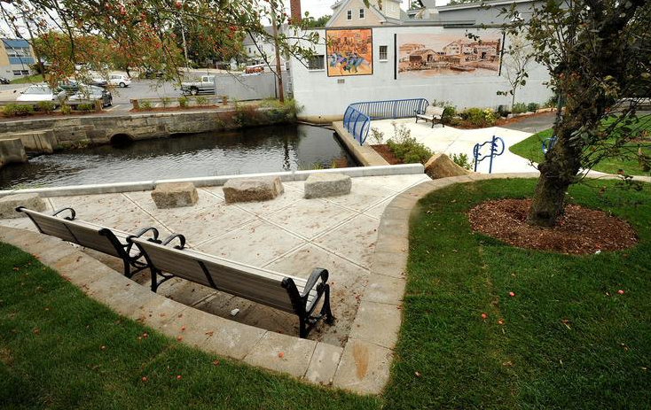
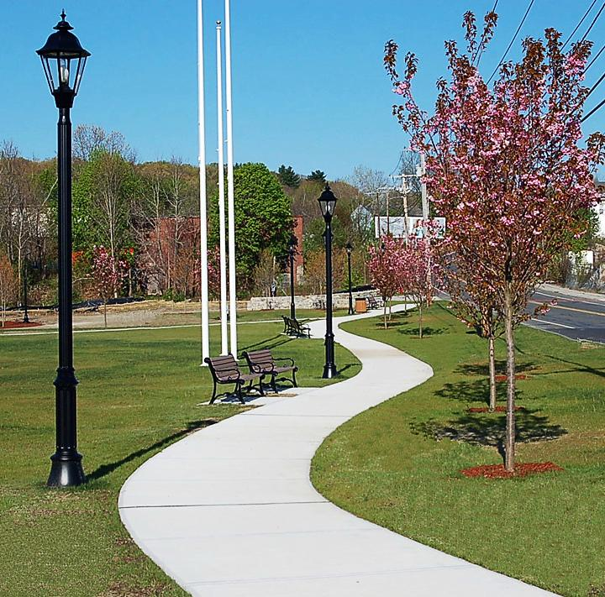
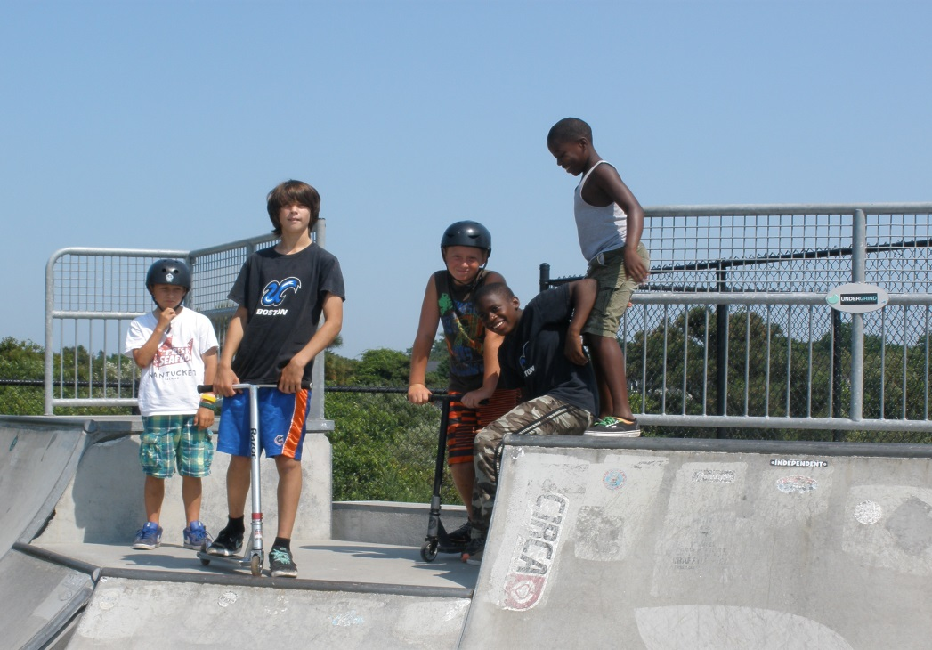
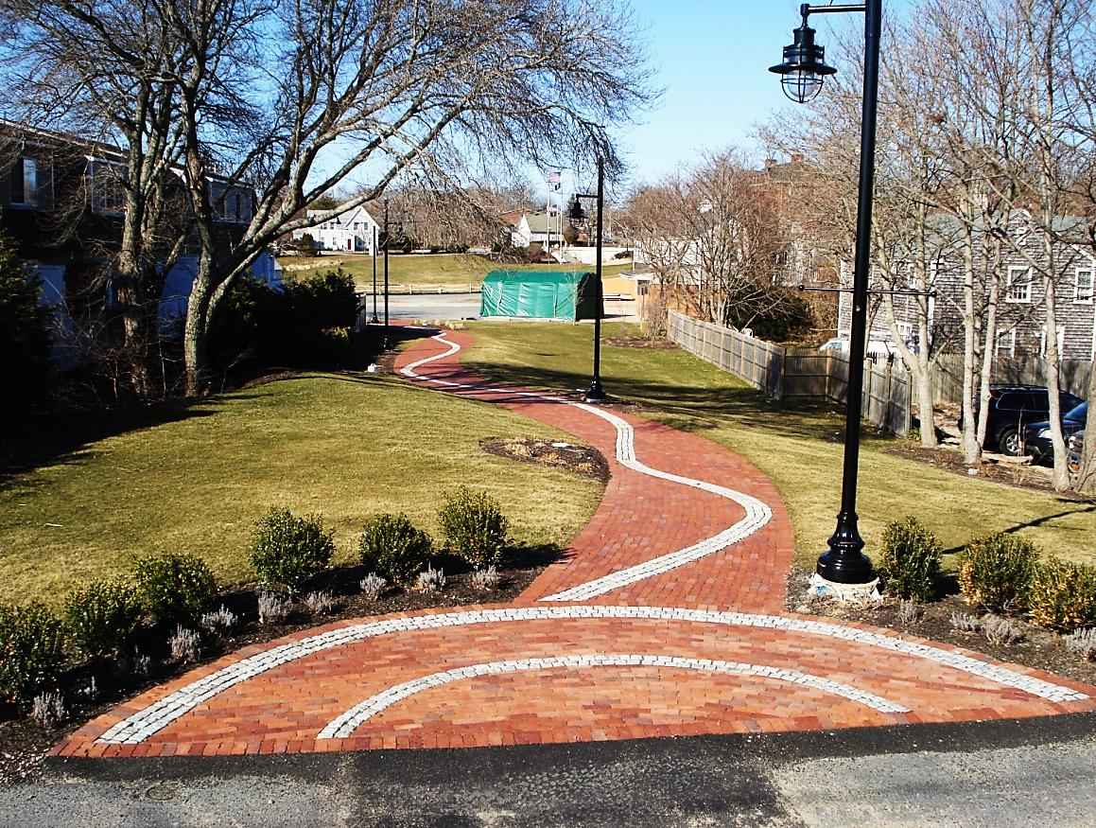
CPA and Open Space/Recreation
Parks
Notes:
Weymouth Herring Run park
Barnstable pocket park
Nantucket skateboard park

Slide 34
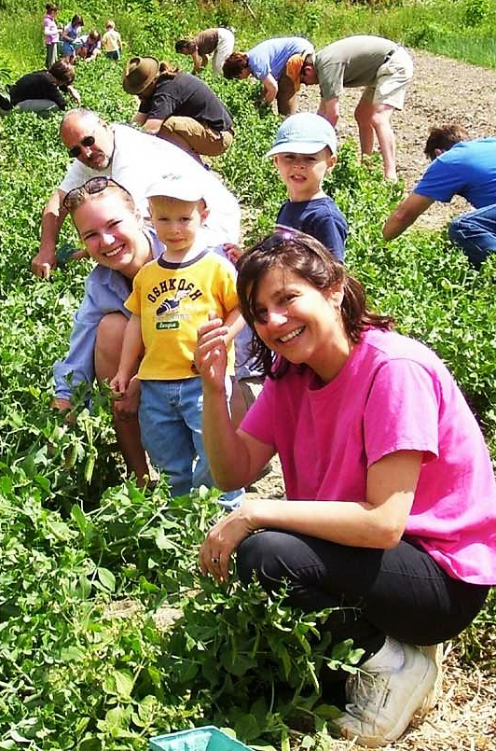
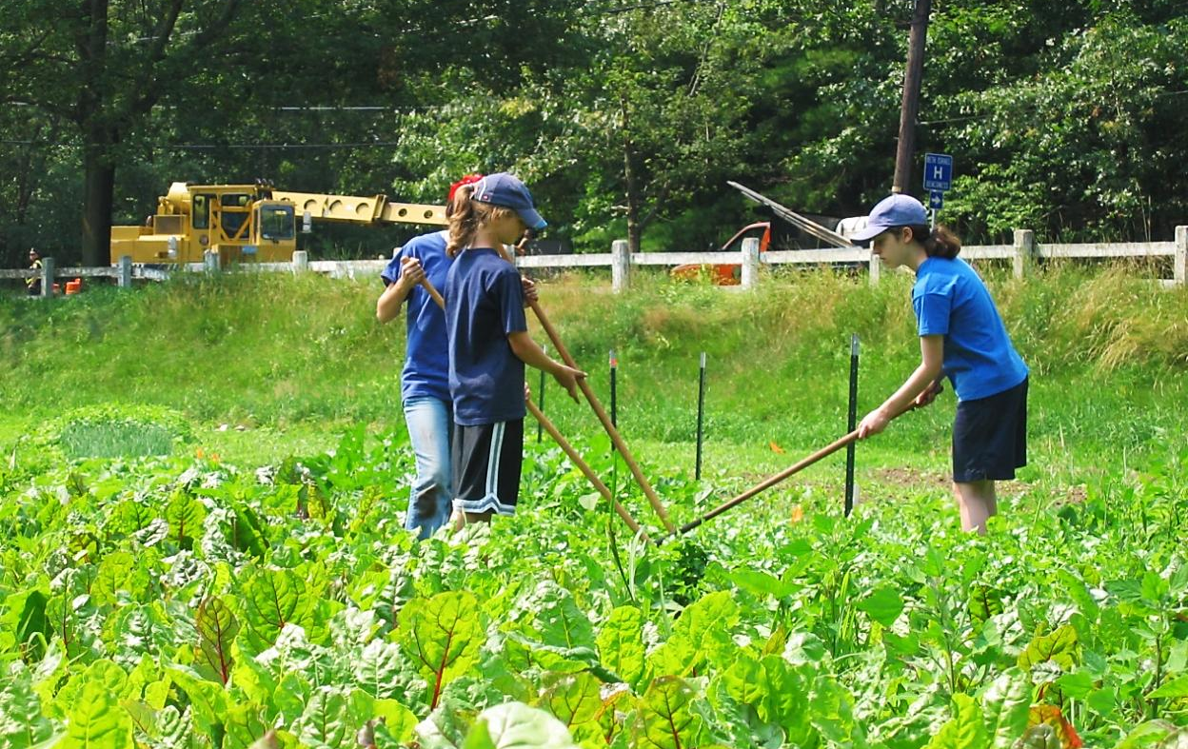
CPA and Open Space/Recreation
Community Gardens
Notes:
Williamstown farm
Newton Angino farm

Slide 35

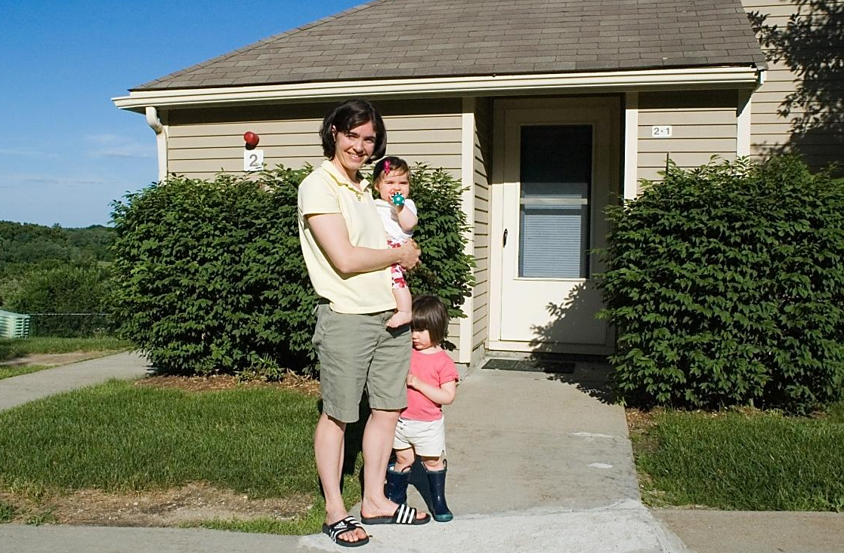
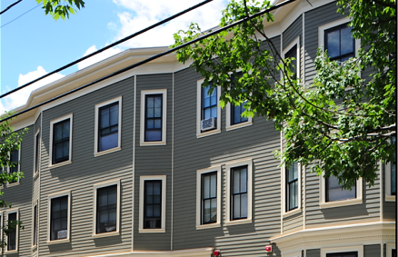
CPA and Affordable Housing
For families & individuals
earning up to 100% of
areawide median income:
  $72,380 for 1 person
  $82,720 for a couple
  $103,400 for a family of 4
  All local zoning and bylaws apply
  Council approval required
  Permanently affordable
Notes:
Stow Pilot Grove affordable housing
Cambridge affordable housing

Slide 36
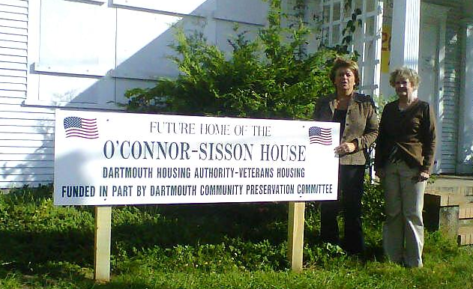
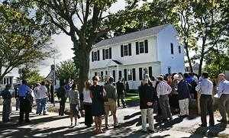
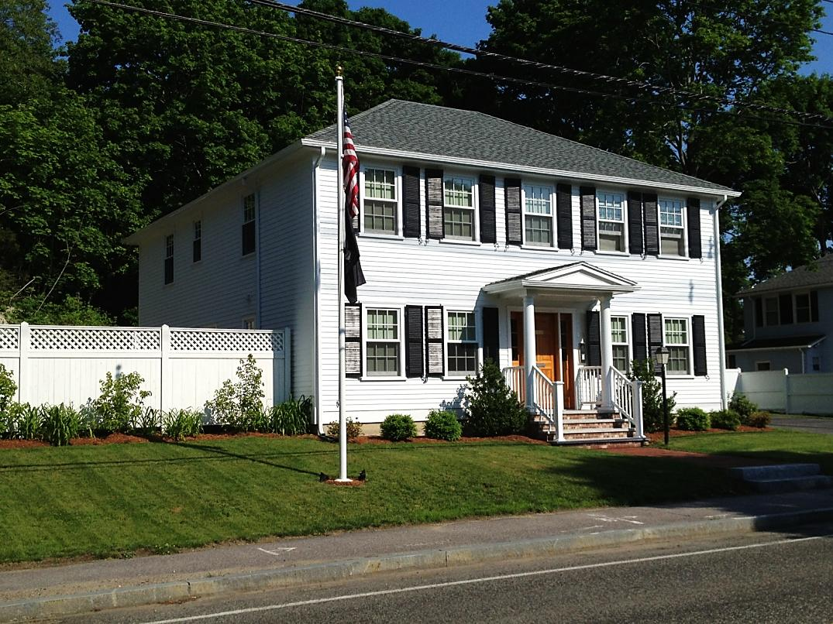
CPA and Affordable Housing
Housing for Veterans
Notes:
- Dartmouth housing for veterans
- Hingham housing for veterans
- Quincy housing for veterans

Slide 37
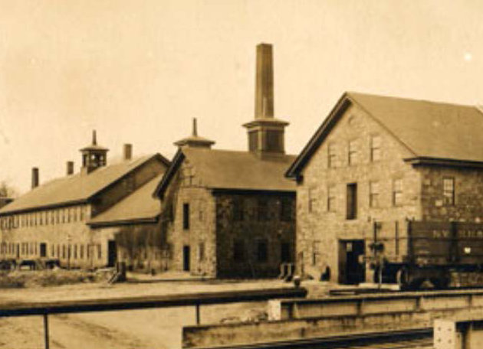
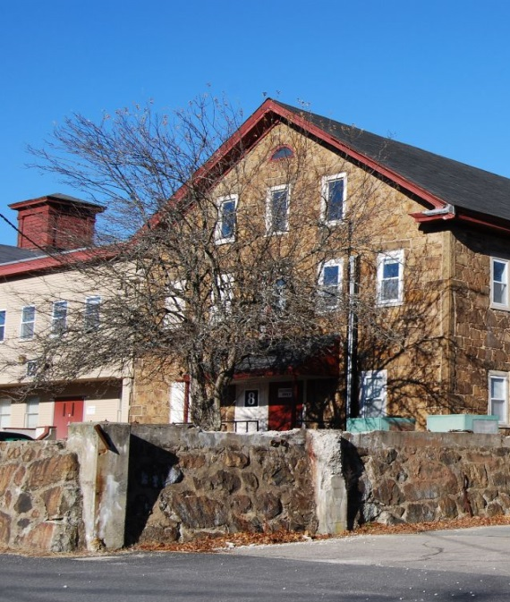
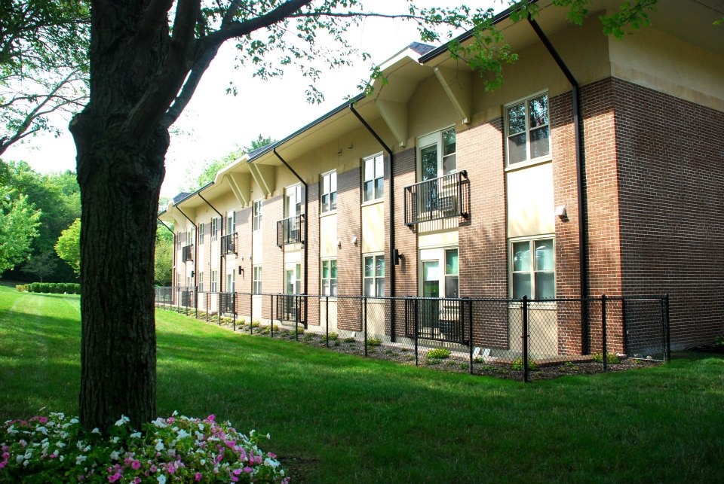
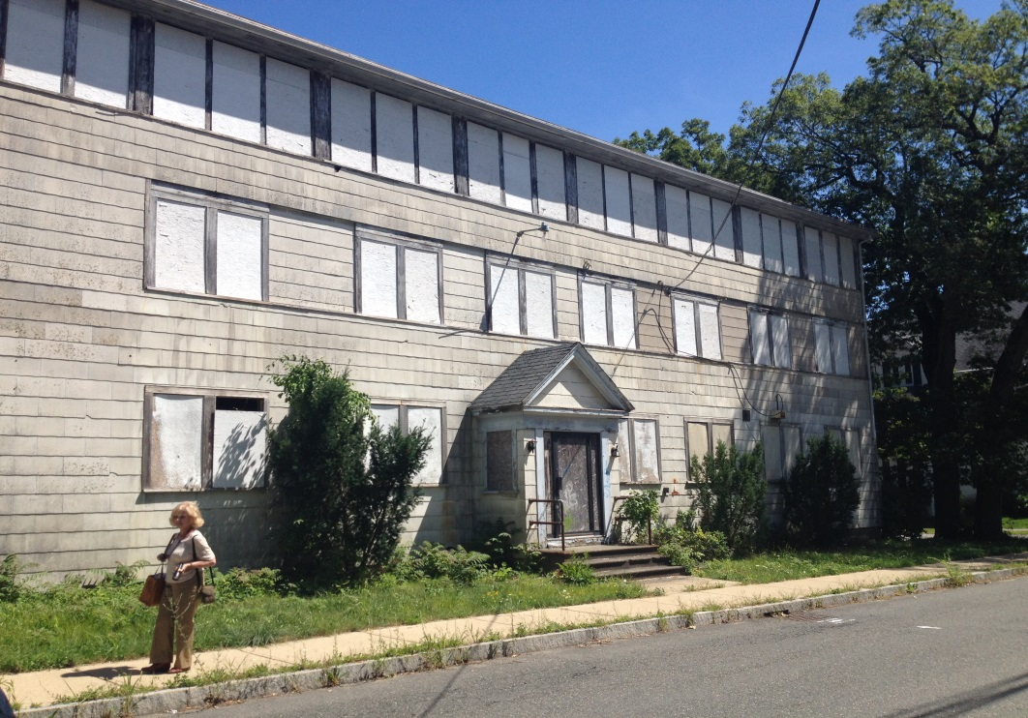
CPA and Affordable Housing
Adaptive Reuse of Existing Buildings
Notes:
Historic Shovel Shop in Easton BEFORE
Historic Shovel Shop in Easton AFTER turned into affordable housing
Cohasset Library turned into affordable housing for seniors

Slide 38
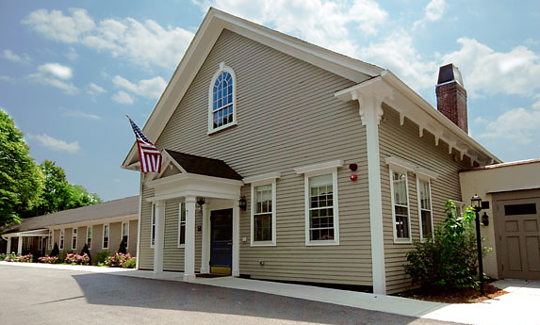


CPA and Affordable Housing
Meeting Specialized Community Needs
Notes:
- Douglas House (historic print shop turned into housing for brain-injured adults) in Lexington (ALL PHOTOS)

Slide 39



CPA and Affordable Housing
Community Involvement
and Non-profit Partnerships
Notes:
Housing built by Habitat for Humanity in Martha’s Vineyard,
Housing built by Habitat for Humanity in Scituate
Construction crew from local technical school in Lincoln working on CPA-funded affordable home

Slide 40

Contact Us
Technical Assistance Hotline
617-367-8998
Stuart Saginor
Executive Director
Alison Leary
Associate Director
Chase Mack
Communications Director
Kaitlin Butler
Kuehn Fellow

Slide 41

Questions?

